Slide 1
Structural Design Patterns
Instructor: Mehroze Khan

Slide 2
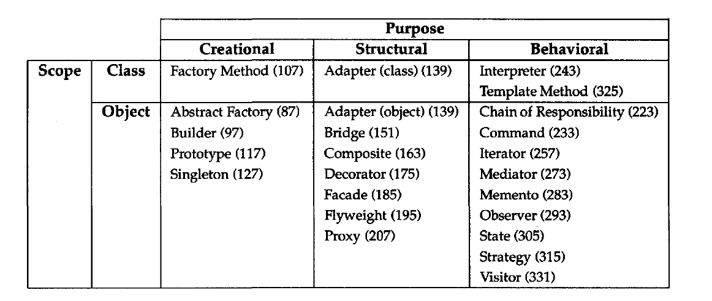
Structural Design Patterns
Structural design patterns explain how to assemble objects and classes into larger structures, while keeping these structures flexible and efficient.
Structural class patterns use inheritance to compose interfaces or implementations.

Slide 3
Composite Pattern

Slide 4
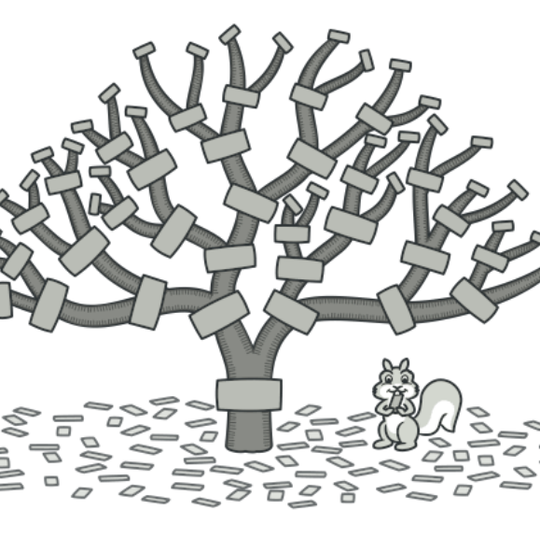
Composite Design Pattern
Also Known as: Object Tree
Intent:
Composite is a structural design pattern that lets you compose objects into tree structures and then work with these structures as if they were individual objects.

Slide 5
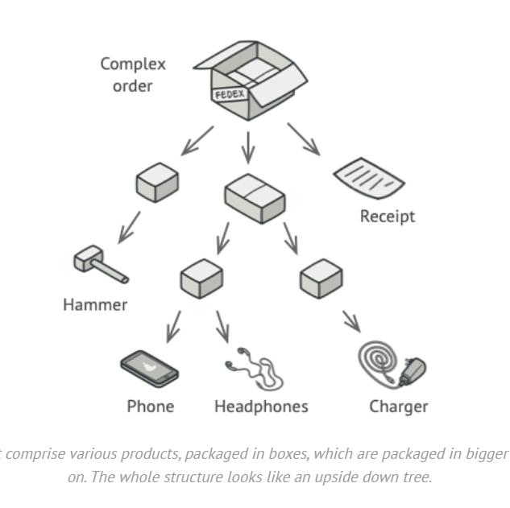
Problem
Using the Composite pattern makes sense only when the core model of your app can be represented as a tree.
For example, imagine that you have two types of objects: Products and Boxes.
A Box can contain several Products as well as several smaller Boxes. These little Boxes can also hold some Products or even smaller Boxes, and so on.
Say you decide to create an ordering system that uses these classes. Orders could contain simple products without any wrapping, as well as boxes stuffed with products...and other boxes. How would you determine the total price of such an order?

Slide 6
Problem
You could try the direct approach: unwrap all the boxes, go over all the products and then calculate the total.
That would be doable in the real world; but in a program, it’s not as simple as running a loop.
You must know the classes of Products and Boxes you’re going through, the nesting level of the boxes and other nasty details beforehand.
All of this makes the direct approach either too awkward or even impossible.

Slide 7
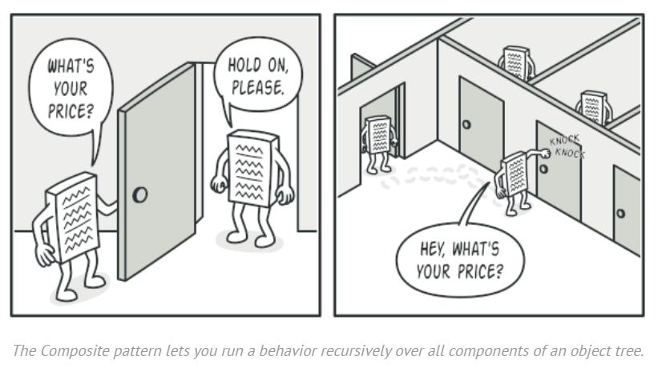
Solution
The Composite pattern suggests that you work with Products and Boxes through a common interface which declares a method for calculating the total price.
How would this method work?
For a product, it’d simply return the product’s price.
For a box, it’d go over each item the box contains, ask its price and then return a total for this box.
If one of these items were a smaller box, that box would also start going over its contents and so on, until the prices of all inner components were calculated.
A box could even add some extra cost to the final price, such as packaging cost.

Slide 8
Solution
The greatest benefit of this approach is that you don’t need to care about the concrete classes of objects that compose the tree.
You don’t need to know whether an object is a simple product or a sophisticated box.
You can treat them all the same via the common interface. When you call a method, the objects themselves pass the request down the tree.

Slide 9
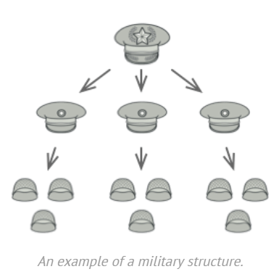
Real World Analogy
Armies of most countries are structured as hierarchies.
An army consists of several divisions; a division is a set of brigades, and a brigade consists of platoons, which can be broken down into squads.
Finally, a squad is a small group of real soldiers. Orders are given at the top of the hierarchy and passed down onto each level until every soldier knows what needs to be done.

Slide 10
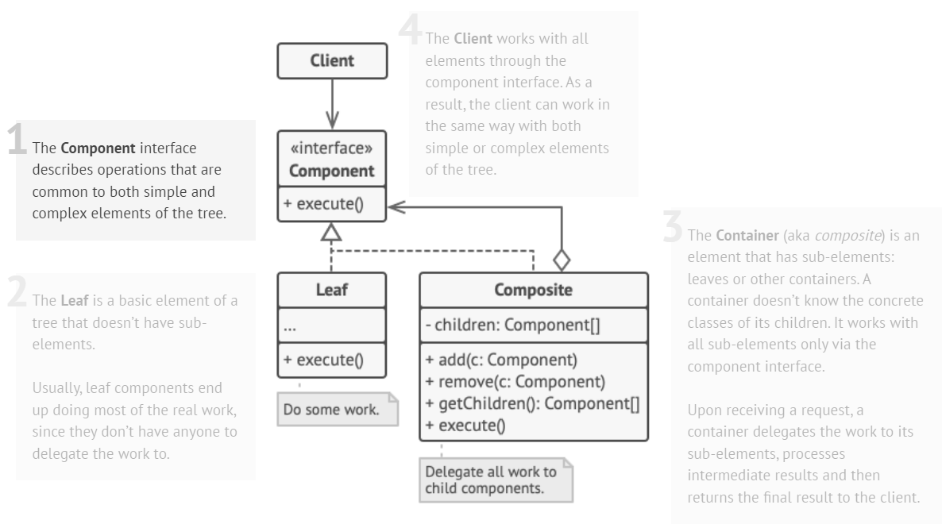
Structure

Slide 11
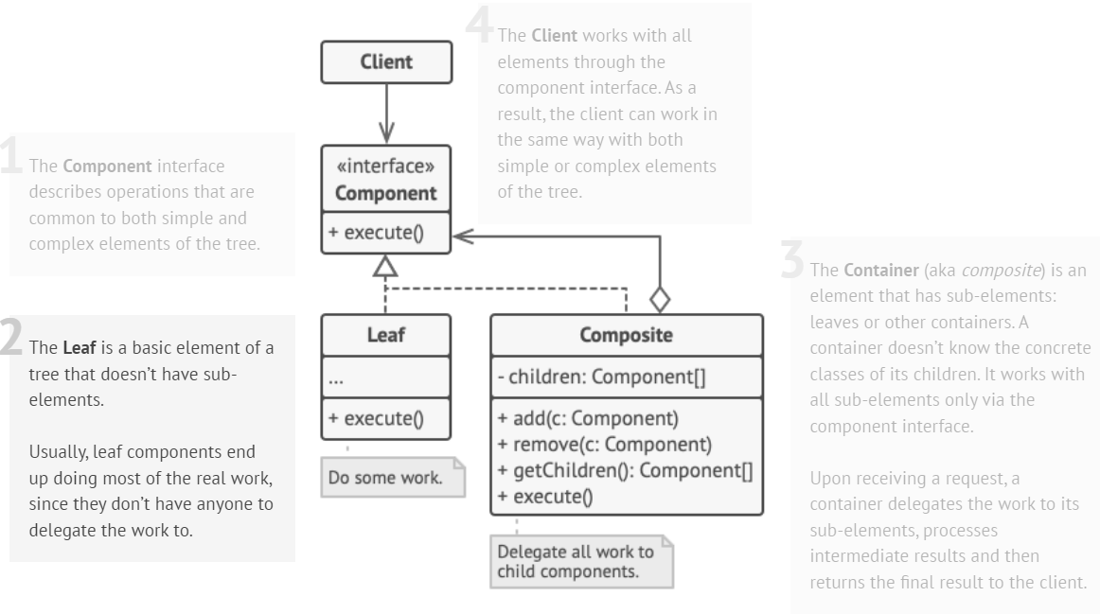
Structure

Slide 12
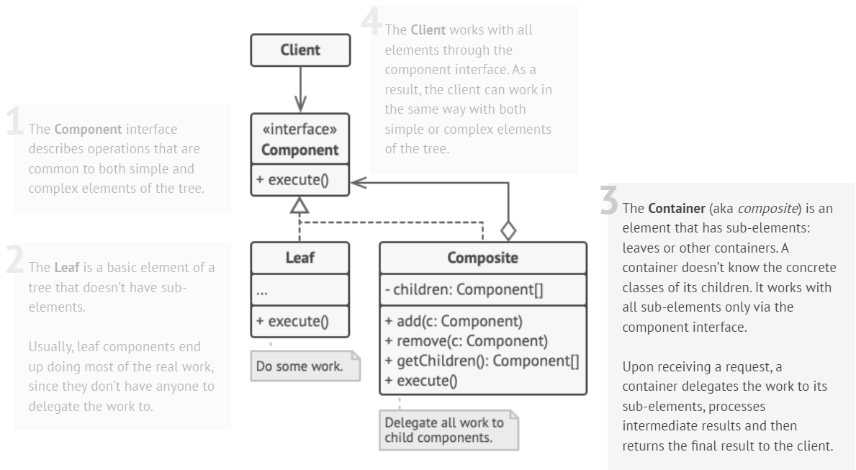
Structure

Slide 13
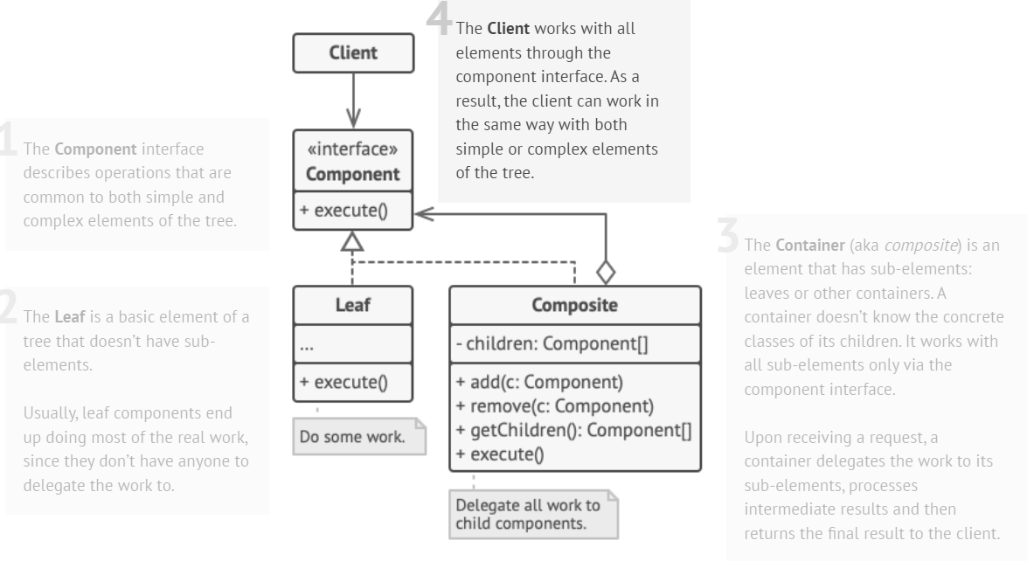
Structure

Slide 14
Example
// Component interface
class Item {
public:
virtual double getPrice() const = 0;
};
// Leaf class (Product)
class Product : public Item {
private:
double price;
public:
Product(double p) {
price = p;
}
double getPrice() const override {
return price;
}
};
// Composite class (Box)
class Box : public Item {
private:
vector<Item*> items;
public:
void add(Item* item) {
items.push_back(item);
}
double getPrice() const override {
double totalPrice = 0.0;
for (const auto& item : items) {
totalPrice += item->getPrice();
}
return totalPrice;
}
};

Slide 15
Example
int main() {
// Creating products
Item* product1 = new Product(20.0);
Item* product2 = new Product(30.0);
// Creating boxes
Box box1;
Box box2;
// Adding products to boxes
box1.add(product1);
box2.add(product2);
// Adding boxes to another box
Box mainBox;
mainBox.add(&box1);
mainBox.add(&box2);
// Calculating total price of the main box
double totalPrice = mainBox.getPrice();
cout << "Total Price of the main box: " << totalPrice << endl;
}
Output:
Total Price of the main box: 50

Slide 16
References
Design Patterns: Elements of Reusable Object-Oriented Software, Erich Gamma, Richard Helm, Ralph Johnson, and John Vlissides, Pearson, 1995.
Helping Links:
https://refactoring.guru/design-patterns/
https://sourcemaking.com/design_patterns/
https://www.youtube.com/watch?v=Q1jZ4TI6MF4&t=297s&ab_channel=Telusko

